Slide 1
Information Security Strategies and Policy
Prof. Blair MacIntyre
Prof. Peter Swire
CS4803 & 6725; MGT4803 & 8803
January 5, 2015

Slide 2
Overview of Today’s Class
Introduction to the course
MacIntyre
Swire
Tech: Wearables and cybersecurity
http://www.wired.com/2014/11/where-fitness-trackers-fail/
Policy/Law: Sony and North Korea – what is a “proportionate response”?

Slide 3
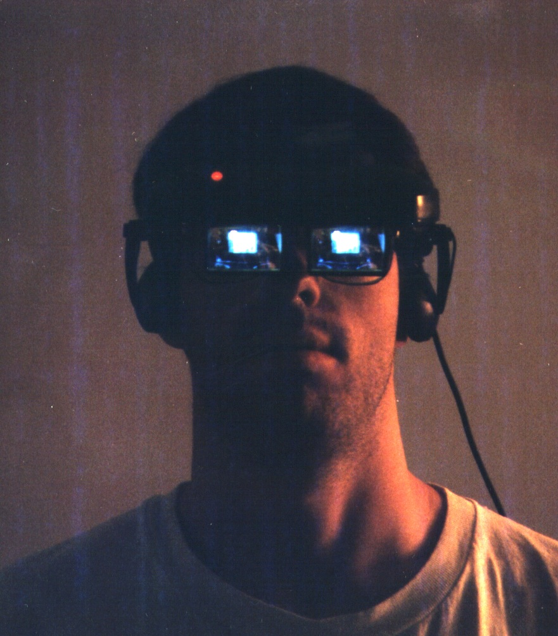
Blair MacIntyre
CM co-designer, now Program Director
Teaching
CS4455 Game Design and Programming
CS4803GS Game Studio (w/ Ian Bogost)
CS4803HAR Handheld AR Game Design (w/ SCAD)
CS4750 Mixed Reality Experience Design (w/ Jay Bolter)
Research in HCI and 3D Graphics, Augmented and Mixed Reality (“interactive 3D in the world”)
Professor in IC and Adjunt Professor in LMC
Design of MR/AR experiences
Background in math, CS, 3D graphics
PhD research in distributed interactive 3D software design

Slide 4
Swire Background for Cyber
Internet law, policy, tech since early 90s
Pres. Clinton Chief Counselor for Privacy
Encryption, intrusion detection, cybercrime, surveillance
Security & privacy advisory boards for Intel, Microsoft, Google, IBM and start-ups
President Obama’s Review Group on Intelligence and Communications Technology (post-Snowden)

Slide 5
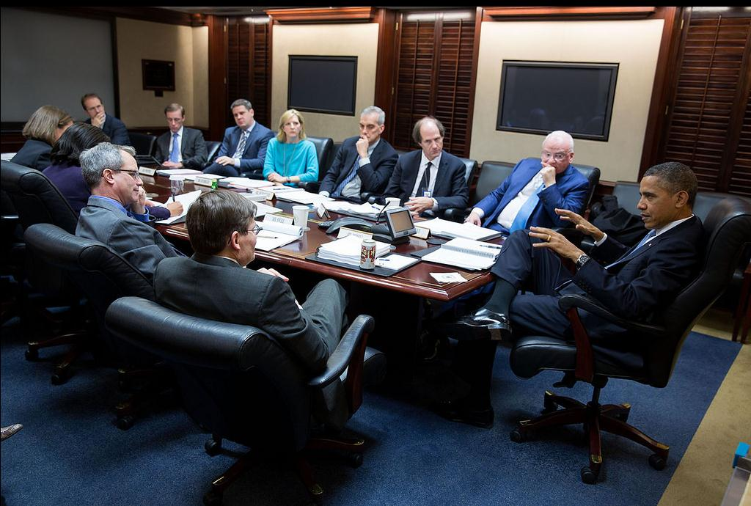
December 2013: The Situation Room

Slide 6
Syllabus and Readings
Questions/comments?

Slide 7
Wearables
http://www.wired.com/2014/11/where-fitness-trackers-fail/

Slide 8
Sony & North Korea
Facts
Assume North Korea government source of attacks
Group assignment:
What is proper response by US government?
Any different if independent sympathizers with NK?
Any different if China helped NK substantially?
Any steps by Sony against NK?

Slide 9
Obama Administration response
http://www.thestar.com/news/world/2015/01/02/obama_orders_sanctions_against_north_korea_over_cyberattack_on_sony.html

