Slide 1
Scintillation “The project formerly known as Dancing Lights”
Team jollyCoop
Nick Watson
Tan Pham
Andrew Darrohn

Slide 2
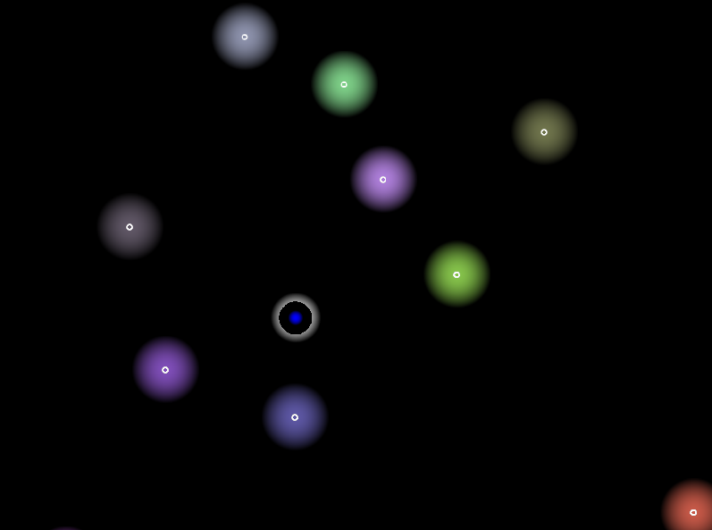
General Idea
Bullet hell rhythm game
Advance to end of level in order to fight and kill the boss.
Full spectrum of colors / effect

Slide 3
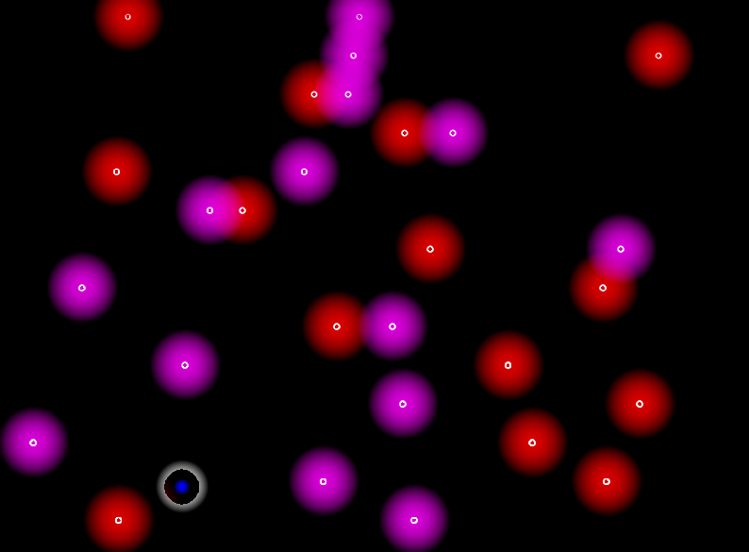
Game Components
Player Ability: Dash (speed boost)
Power Ups
Music determines bullet pattern
Orientation switch
Variability of movements
Increase difficulty with time

Slide 4
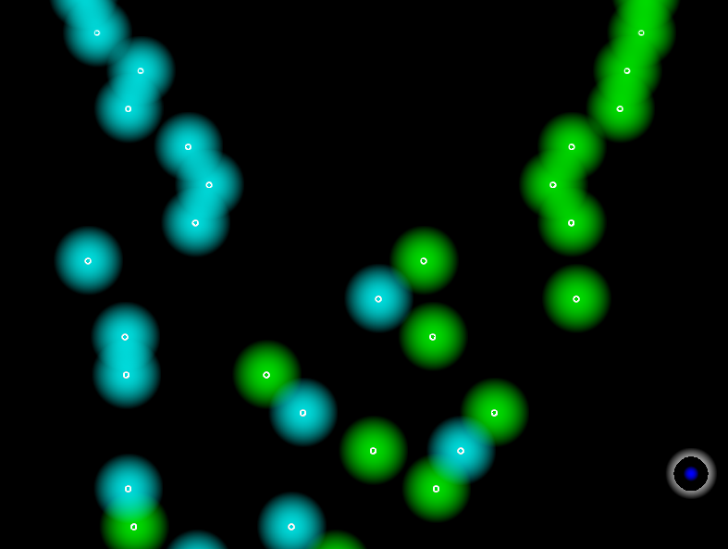
Target Experience
Music should help player get into a rhythm (in the zone)
Lights & Effects should create a scintillating experience for the player
Effects should be awe inspiring
Movement should be reactionary & fluid

